Slide 1
INTRODUCTION TO MRI
Lynne J. Williams, Ph.D.
BCCH MRI Research Facility
May 29, 2018
DTI I

Slide 2
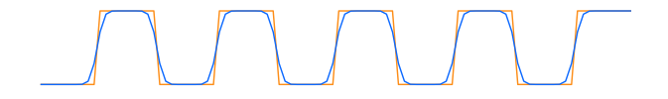
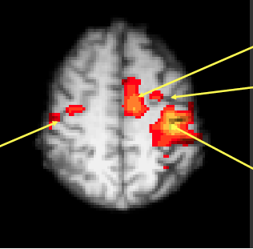
fMRI signal
Task paradigm
rest
move
rest
move
rest
move
rest
move
rest
move
Time
ACTIVATION
FOR MOVEMENT
VS REST
SMA
PMCc
M1i
M1c

Slide 3
PROBLEMS WITH SUBTRACTION DESIGNS
Depends upon assumption of pure insertion
Idea that you can insert a single component process into a task without affecting other processes
A
B
A + B
A × B
A × B
Sonia Bishop after
Friston et al. 1996, Neuroimage

Slide 4
FACTORIAL DESIGNS
 | No vision | Vision
No touch |  | 
Touch |  | 
}
MAIN EFFECT
OF TOUCH
}
MAIN EFFECT OF VISION
Allow you to examine interactions between component processes without assuming pure insertion

Slide 5
CONJUNCTION DESIGNS
Cognitive subtraction
 | Task
 | A | B
Process 1
2
3
4
5
Cognitive Conjunction
 | Task Pair 1 |  | Task Pair 2
 | A | B | A | B
Process 1
2
3
4
5
Activation vs. baseline
Commonalities in activation vs. baseline across task pairs
Price & Friston (1997). Neuroimage 5, 261-170

Slide 6
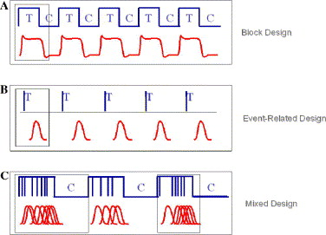
Block design
Event-related design
Mixed design
Amaro, Jr. & Barker (2006). Study Design in fMRI: Basic Principles. Brain & Cognition, 60, 220-232.

Slide 7
WEEK 5
DIFFUSION MRI I
TODAY’S CLASS
The diffusion principle
Diffusion measured by MRI
The tensor model
Imaging of diffusivity

Slide 8
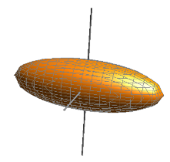
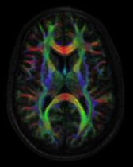
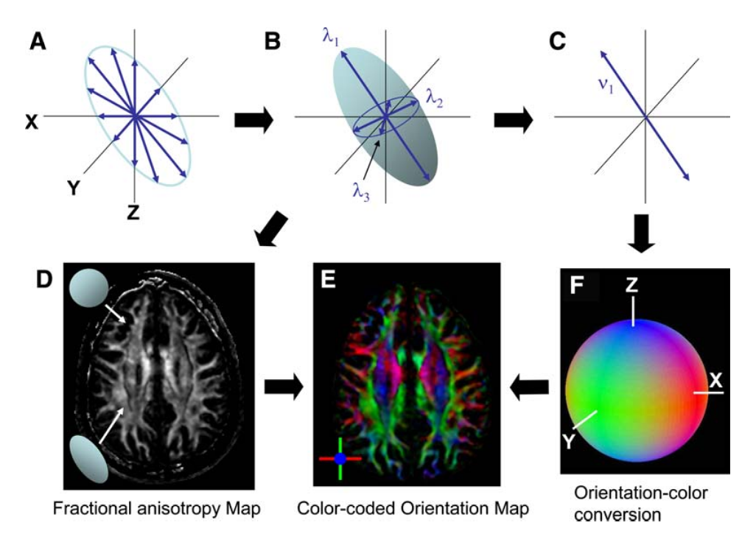
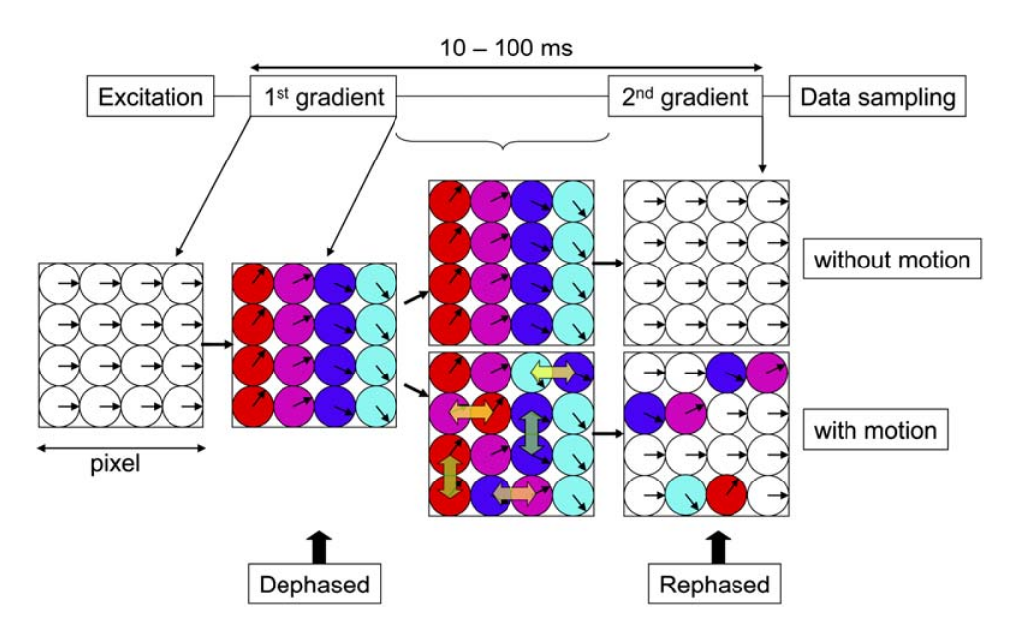
DIFFUSION TENSOR IMAGING
Diffusion Tensor Imaging (DTI) is an anatomical MRI technique that measures macroscopic axonal organization in the brain by using the diffusion of water molecules to generate contrast in MR images.
tensor
imaging
diffusion
Davide Bono & Roser Cañigueral (2017)
University College London
Notes:
8

Slide 9
DIFFUSION TENSOR IMAGING
WATER protons = signal in DTI
Diffusion property of water molecules (D)
D = diffusion constant
Move by Brownian motion / Random thermal motion
Image intensities inversely related to the relative mobility of water molecules in tissue and the direction of the motion

Slide 10
DIFFUSION TENSOR IMAGING
THE DIFFUSION PRINCIPLE
Brownian/translational motion of water molecules.
This motion is influenced by Fick’s Law
a solute will move from a region of high concentration to a region of low concentration across a concentration gradient
Davide Bono & Roser Cañigueral (2017)
University College London
Notes:
J is the "diffusion flux," of which the dimension is amount of substance per unit area per unit time, so it is expressed in such units as mol m⁻² s⁻¹. J measures the amount of substance that will flow through a unit area during a unit time interval.
D is the diffusion coefficient or diffusivity. Its dimension is area per unit time, so typical units for expressing it would be m²/s.
φ {\displaystyle \varphi } (for ideal mixtures) is the concentration, of which the dimension is amount of substance per unit volume. It might be expressed in units of mol/m³.
x is position, the dimension of which is length. It might thus be expressed in the unit m.
D is proportional to the squared velocity of the diffusing particles, which depends on the temperature, viscosity of the fluid and the size of the particles according to the Stokes-Einstein relation. In dilute aqueous solutions the diffusion coefficients of most ions are similar and have values that at room temperature are in the range of 0.6 × 10⁻⁹ to 2 × 10⁻⁹ m²/s. For biological molecules the diffusion coefficients normally range from 10⁻¹¹ to 10⁻¹⁰ m²/s.
10

Slide 11
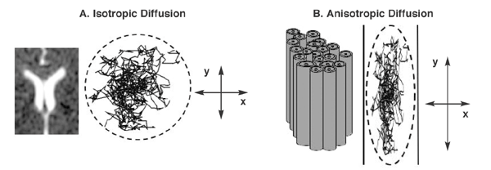
DIFFUSION TENSOR IMAGING
THE DIFFUSION PRINCIPLE

Slide 12
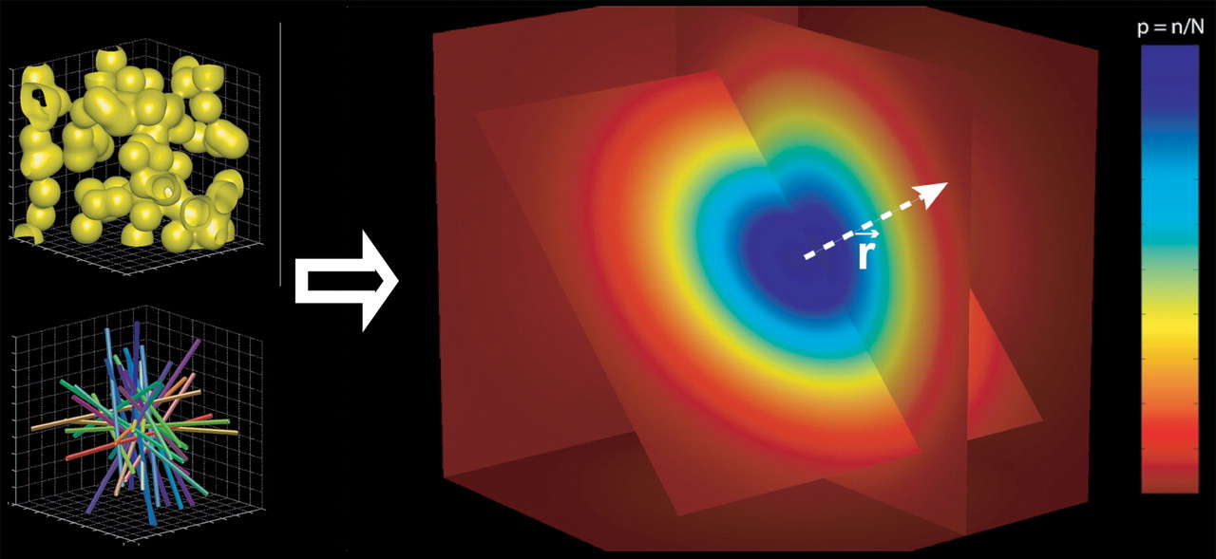
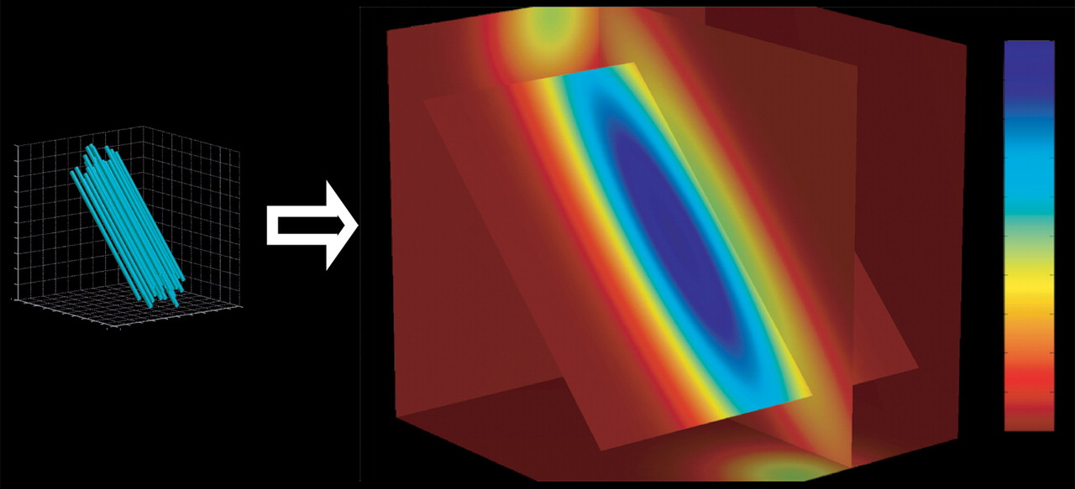
DIFFUSION TENSOR IMAGING
THE DIFFUSION PRINCIPLE
In an unrestricted environment, water molecules move randomly → Isotropy
In a constrained environment, water molecules diffuse more easily along one axis → Anisotropy
Davide Bono & Roser Cañigueral (2017)
University College London
Notes:
12

Slide 13
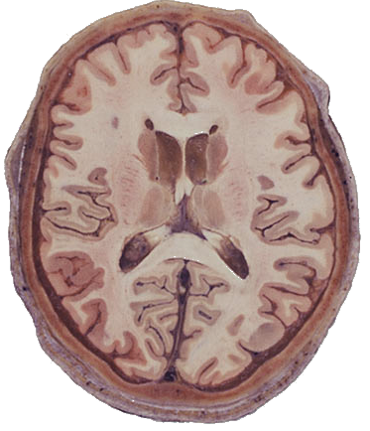
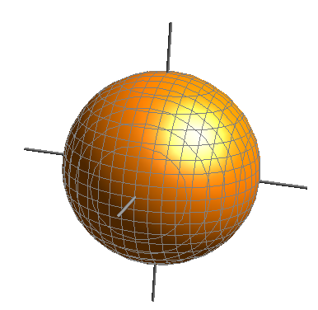

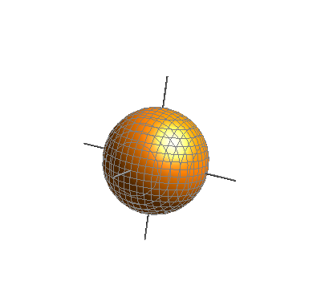
DIFFUSION TENSOR IMAGING
THE DIFFUSION PRINCIPLE
CSF
Isotropic
High diffusivity
WHITE MATTER
Anisotropic
High diffusivity
GREY MATTER Isotropic
Low diffusivity
Davide Bono & Roser Cañigueral (2017)
University College London

Slide 14
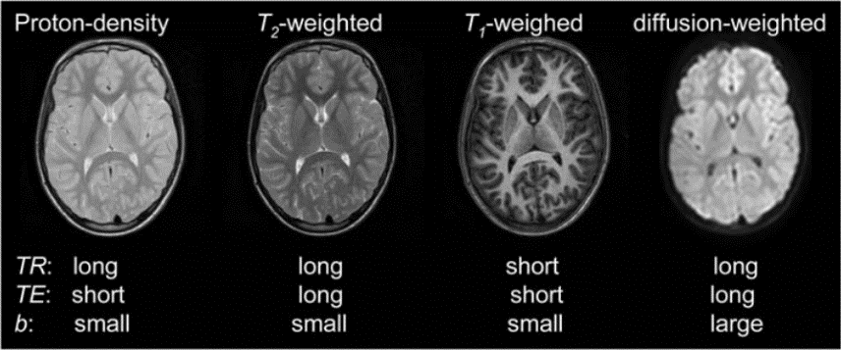
Signal from proton nuclei in water molecules
The contrast/signal (S) can be modified based on the physical properties of water:
PD (proton density)
T₁ relaxation time
T₂ relaxation time
D (diffusion coefficient)
DIFFUSION
TENSOR
IMAGING
Davide Bono & Roser Cañigueral (2017)
University College London

Slide 15
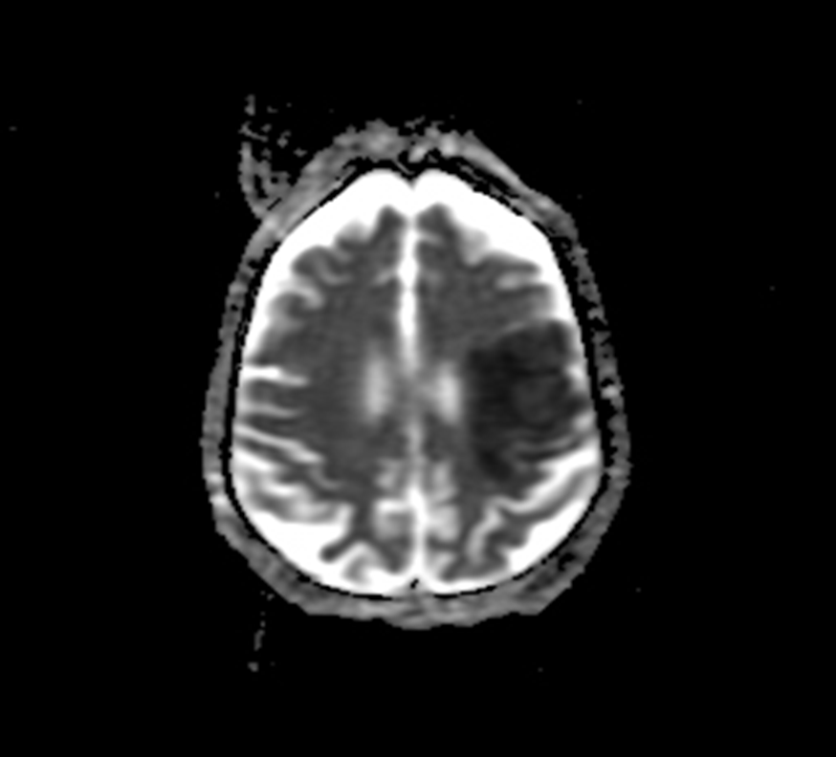
DIFFUSION TENSOR IMAGING APPARENT DIFFUSION COEFFICIENT
Dark regions
water diffusing more slowly
more obstacles to movement OR increased viscosity
Bright regions
water diffusing more quickly
Intensity of voxels proportional to extent of diffusion
Marija Cauchi and Kenji Yamamoto
Left MCA stroke – www.radiopaedia.org
Notes:
Measurements along the structures (e.g. axon bundles) leads to higher ADC
Measurements perpendicular to structures leads to lower ADC

Slide 16
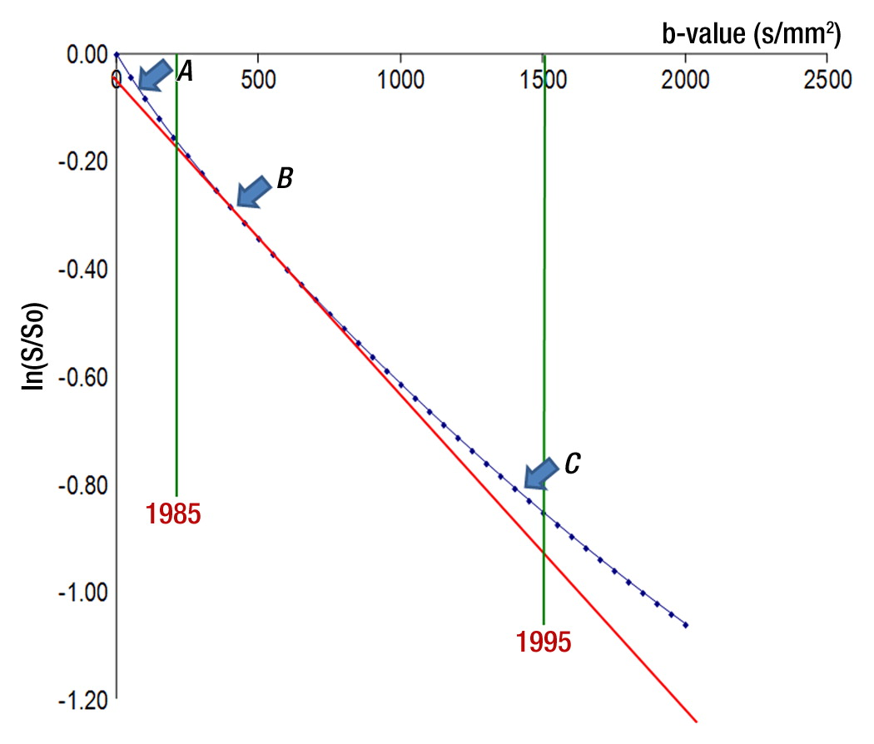
DIFFUSION
TENSOR
IMAGING
Slope = ADC
APPARENT DIFFUSION COEFFICIENT (ADC)
Slope of ADC decreases with b value
(due to non-Gaussian nature in tissues)
Le Bihan; Radiology 2013, 268, 318-322.
DOI: 10.1148/radiol.13130420
© RSNA, 2013
Notes:
Plot of the diffusion MR imaging signal attenuation (S/S0) against the b value. The plot is straight only with intermediate b values (arrow B). The slope is then the ADC. At very low b values (arrow A), the slope is higher, with the inclusion of perfusion (intravoxel incoherent motion effect). At higher b values (arrow C), the plot gets curved and the slope (ADC) decreases with the b value, reflecting its non-Gaussian nature in tissues (hindrance of diffusion by tissue elements, such as cell membranes). Around 1985, only very low b values were available. Around 1995, b values around 1500 sec/mm2 became common, while today very high b values (5000 sec/mm2 and higher) can be reached.

Slide 17
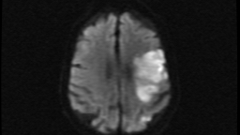
DIFFUSION WEIGHTED IMAGING
DWI
Bright regions
decreased water diffusion
Dark regions
increased water diffusion
ADC
www.radiopaedia.org

Slide 18
DWI
ADC
Hygino da Cruz Jr, Neurology 2008

Slide 19
WHAT IS b-VALUE?
b-value gives the degree of diffusion weighting
related to the strength (G) and duration (δ) of the pulse gradient as well as the interval between the gradients (Δ)
b-value changes by lengthening the separation of the 2 gradient pulses
more time for water molecules to move around
more signal loss (imperfect rephasing)
Marija Cauchi and Kenji Yamamoto

Slide 20
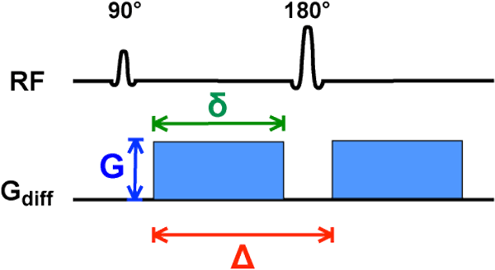
PULSED GRADIENT SPIN ECHO
DIFFUSION TENSOR IMAGING
WHAT IS b?
Stejskal and Tanner 1965 after
http://mriquestions.com/what-is-the-b-value.html
Notes:
This technique still forms the basis for most modern DWI pulse sequences and consists of two strong gradient pulses of magnitude (G) and duration (δ), separated by time interval (Δ)

Slide 21
DIFFUSION TENSOR IMAGING
DIFFUSION MEASURED BY MRI
SIGNAL LOSS
(higher b or D = lower S)
Davide Bono & Roser Cañigueral (2017)
University College London
Notes:
21

Slide 22
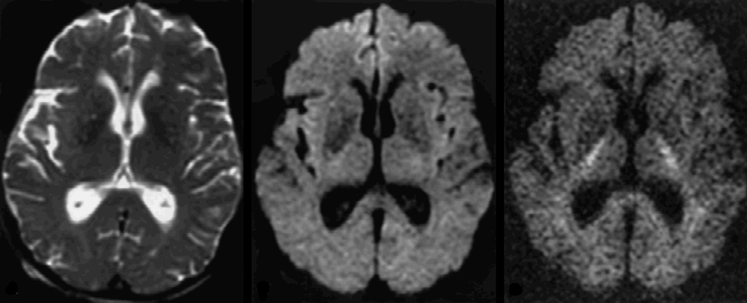
Optimal b value?
DIFFUSION TENSOR IMAGING
DIFFUSION MEASURED BY MRI
b = 0
b = 1000
b = 3000
http://mriquestions.com/what-is-the-b-value.html

Slide 23
It depends
DIFFUSION TENSOR IMAGING
DIFFUSION MEASURED BY MRI
b = 0
b = 1000
b = 3000
http://mriquestions.com/what-is-the-b-value.html
Notes:
Infants → more water, lower b values

Slide 24
Rule of thumb:
DIFFUSION TENSOR IMAGING
DIFFUSION MEASURED BY MRI
b = 0
b = 1000
b = 3000
http://mriquestions.com/what-is-the-b-value.html
Notes:
Infants → more water, lower b values

Slide 25
DIFFUSION TENSOR IMAGING
THE TENSOR MODEL
In the case of anisotropic diffusion: we fit a model to describe our data: TENSOR MODEL
This characterises diffusion in which the displacement of water molecules per unit time is not the same in all directions

Slide 26
DIFFUSION TENSOR IMAGING
THE TENSOR MODEL
MATRIX
TENSOR
A matrix is a grid of n × m numbers surrounded by brackets.
The basic idea is that a matrix is just a 2-D grid of numbers that you can perform mathematical operations on.
.
A tensor is a generalized matrix. The dimension of the tensor is called its rank.
A tensor is a mathematical entity that lives in a structure and interacts with other mathematical entities. If one transforms the other entities in the structure in a regular way, then the tensor must obey a related transformation rule.
This “dynamical” property of a tensor is the key that distinguishes it from a matrix.
https://medium.com/@quantumsteinke/whats-the-difference-between-a-matrix-and-a-tensor-4505fbdc576c

Slide 27
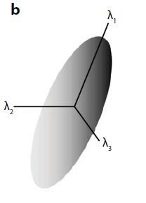
What is the diffusion tensor?
DIFFUSION TENSOR IMAGING
THE TENSOR MODEL
Johansen-Berg et al.
Ann Rev. Neurosci 32:75-94 (2009)

Slide 28
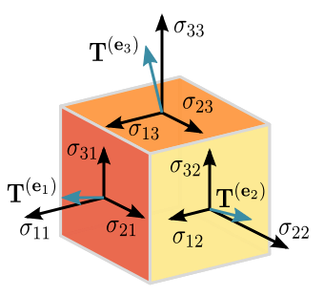
DIFFUSION TENSOR IMAGING
THE TENSOR MODEL

Slide 29
DIFFUSION TENSOR IMAGING
THE TENSOR MODEL
Davide Bono & Roser Cañigueral (2017)
University College London

Slide 30
DIFFUSION TENSOR IMAGING
THE TENSOR MODEL
Davide Bono & Roser Cañigueral (2017)
University College London

Slide 31
DIFFUSION TENSOR IMAGING
THE TENSOR MODEL
EIGEN-
DECOMPOSITION
Eigenvalues
Eigenvectors
diffusivity of axes
(longest, middle, shortest)
orientation of axes
Davide Bono & Roser Cañigueral (2017)
University College London

Slide 32
DIFFUSION TENSOR IMAGING
THE TENSOR MODEL
λ₁, λ₂ and λ₃ are termed the diagonal values of the tensor
λ₁ indicates the value of maximum diffusivity or primary eigenvalue (longitudinal diffusivity)
λ₂ and λ₃ represent the magnitude of diffusion in a plane transverse to the primary one (radial diffusivity) and they are also linked to eigenvectors that are orthogonal to the primary eigenvector

Slide 33
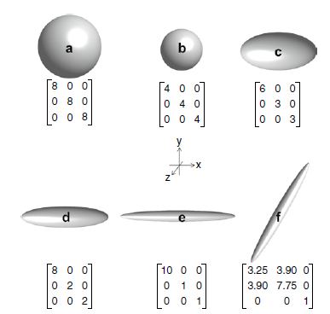
`Diffusion MRI`
Johansen-Berg and Behrens

Slide 34
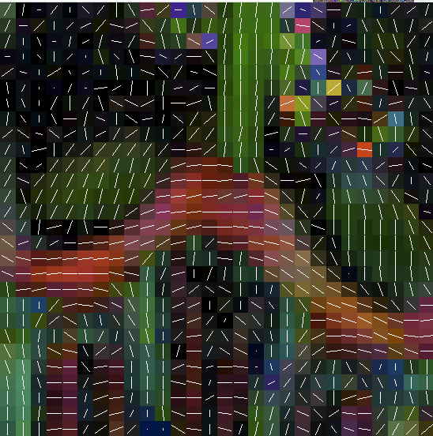
DIFFUSION TENSOR IMAGING
THE TENSOR MODEL
Fit eigenvalues and eigenvectors to a 3D ellipsoid and identify primary eigenvalue for each voxel
for each pixel
Davide Bono & Roser Cañigueral (2017)
University College London

Slide 35
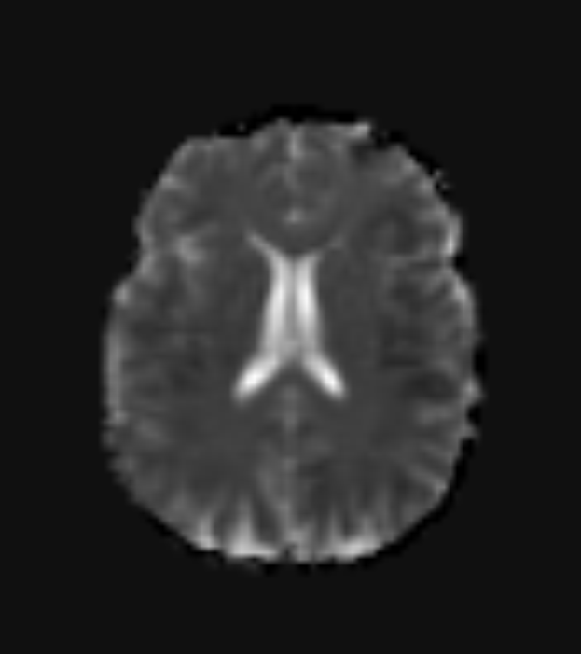
DIFFUSION TENSOR IMAGING
IMAGING DIFFUSIVITY
Mean diffusivity (MD)
Average diffusion at every voxel across trace

Slide 36
DIFFUSION TENSOR IMAGING
IMAGING DIFFUSIVITY
Fractional anisotrophy (FA)
Degree of diffusion anisotrophy at every voxel as estimated by the diffusion model. Values are scalar:
0 = isotropic
1 = anisotropic
Davide Bono & Roser Cañigueral (2017)
University College London

Slide 37
Davide Bono & Roser Cañigueral (2017)
University College London

Slide 38
Davide Bono & Roser Cañigueral (2017)
University College London

Slide 39
FA
V1 MODULATED BY FA
Tranzsverse Axis
(x direction)
Left/Right
Anterior/Posterior axis
(y direction)
Superior/Inferior axis
(z direction)
Davide Bono & Roser Cañigueral (2017)
University College London

Slide 40
WATER DIFFUSION IN BRAIN TISSUE
Depends upon the environment:
Proportion of intracellular vs extracellular water: cytotoxic vs vasogenic oedema
Extracellular structures/large molecules particularly in disease states
Physical orientation of tissue (e.g.nerve fibre direction)
Diffusion is greater in the axis parallel to the orientation of the nerve fibre
Diffusion is less in the axis perpendicular to the nerve fibre

Slide 41
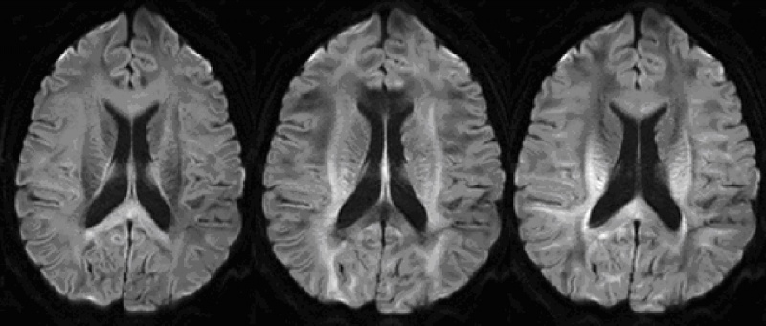
EFFECT OF VARYING GRADIENT DIRECTION
DWI_{z}
DWI_{x}
DWI_{y}

Slide 43
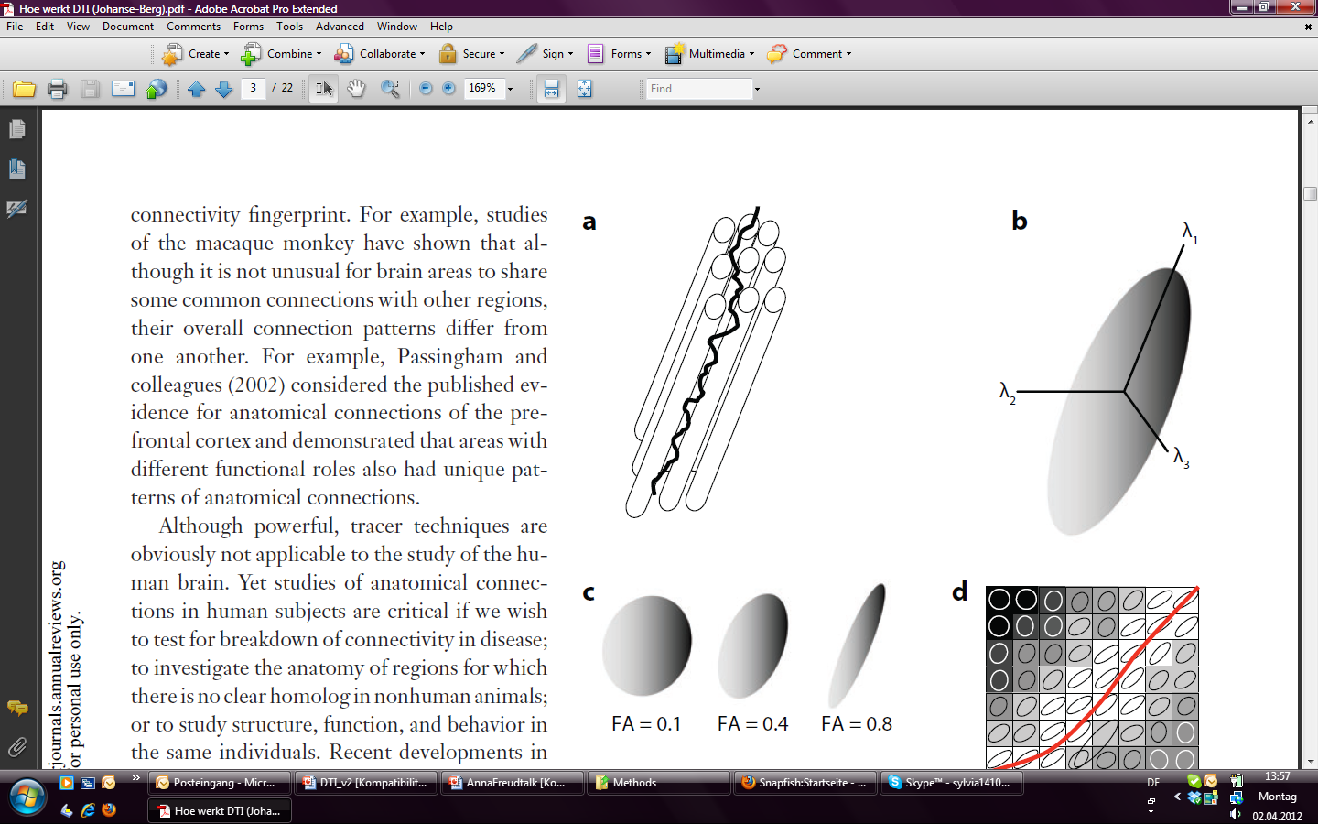
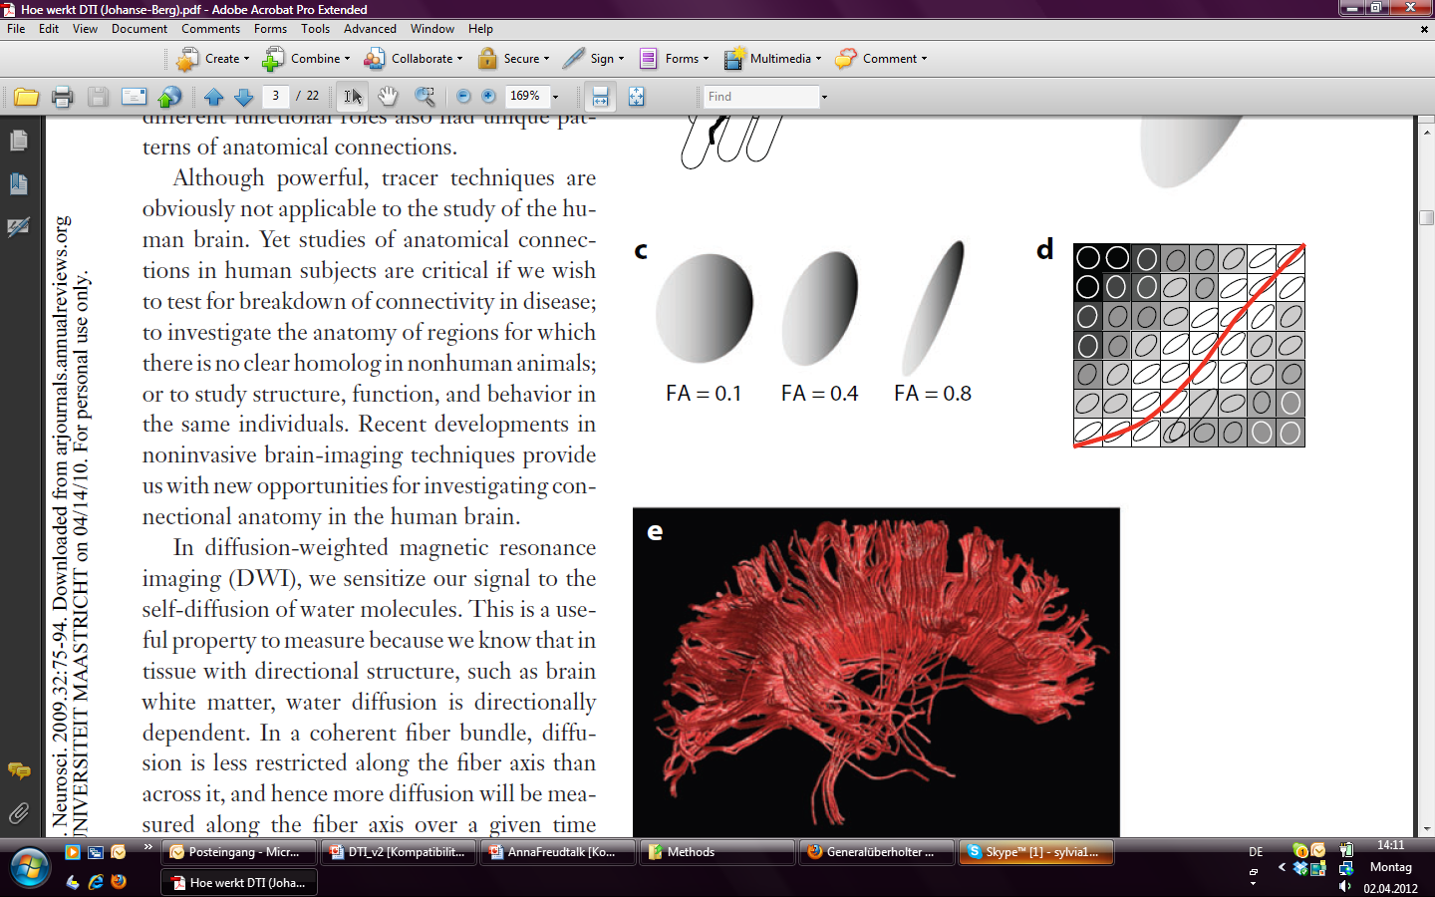
TRACTOGRAPHY OVERVIEW
Not actually a measure of individual axons, rather the data extracted from the imaging data is used to infer where fibre tracts are
Voxels are connected based upon similarities in the maximum diffusion direction
Johansen-Berg et al.
Ann Rev. Neurosci 32:75-94 (2009)

Slide 44
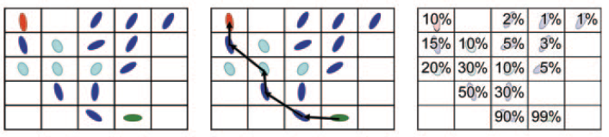
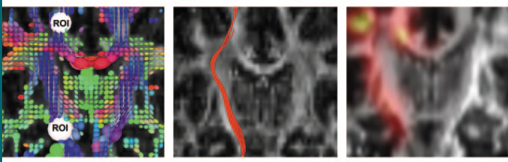
TRACTOGRAPHY TECHNIQUES
Degree of anisotropy Streamline tractography Probabilistic tractography
Nucifora et al. Radiology 245:2 (2007)

Slide 45
STREAMLINE (DETERMINISTIC) TRACTOGRAPHY
Connects neighbouring voxels from user defined voxels
(SEED REGIONS) e.g. M1 for the CST
User can define regions to restrict the output of a tract
e.g. internal capsule for the CST
Tracts are traced until termination criteria are met
e.g. anisotropy drops below a certain level or there is an abrupt angulation
Nucifora et al. Radiology 245:2 (2007)

Slide 46
PROBABILISTIC TRACTOGRAPHY
Value of each voxel in the map = the probability the voxel is included in the diffusion path between the ROIs
Run streamlines for each voxel in the seed ROI
Provides quantitative probability of connection at each voxel
Allows tracking into regions where there is low anisotropy e.g. crossing or kissing fibres
Nucifora et al. Radiology 245:2 (2007)

Slide 47
CROSSING/KISSING FIBRES
Low FA within the voxels of intersection
Crossing fibres
Kissing fibres

Slide 48
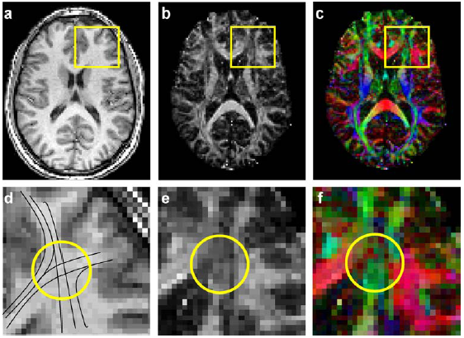
CROSSING/KISSING FIBRES
Assaf et al
J Mol Neurosci 34(1) 51-61 (2008)

Slide 49
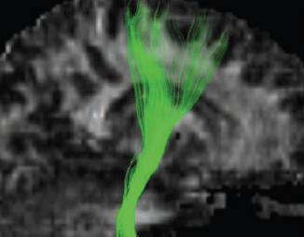
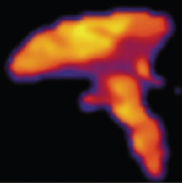
DTI TRACTS
Corticospinal Tracts Streamline
Corticospinal Tracts Probabilistic
Nucifora et al. Radiology 245:2 (2007)

Slide 50
INTRODUCTION TO MRI
DIFFUSION TENSOR IMAGING PART I
THANK YOU

